Slide 1
Sample questions from previous year exam

Slide 2
Question 1:
A Rescue Agent is deployed in a flood-affected city to deliver medicines from the base camp at (X1, Y1) to a relief shelter located at (X5, Y4). The agent must efficiently plan the route to ensure the timely delivery of the medical supplies. The city is represented as a 5x5 grid. The agent is equipped with four distinct actions: Move Up, Move Down, Move Left, and Move Right. However, it cannot move into waterlogged and blocked cells. The city is represented as a 5×5 grid below:

Slide 3
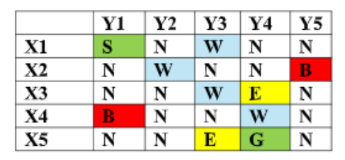
Legend:
S = Start (Base Camp)
G = Goal (Relief Shelter)
N = Normal cell (cost +1)
W = Waterlogged (+5 cost)
E = Energy pack (–2 cost)
B = Blocked (not traversable)

Slide 4
Heuristic:
H(n)=Manhattan Distance to Goal + No. of Waterlogged cells adjacent to position
For the above problem do the following:
a) Expand and depict the search tree for exactly 3 levels. (Level 0 = Start).
b) Calculate path cost and heuristic values for all nodes at Level 1–3.
c) Apply A* search and show all steps.
Manhattan distance = For two points (P(x1, y1)) and (Q(x2, y2)), the formula is: D=|x1-x2|+|y1-y2|)

Slide 5
Initial assumptions from given statement
Grid rules used
Traversable cells: S, N, E, G Non-traversable cells: W, B
Costs:
Heuristic:
H(n)=Manhattan Distance to Goal + No. of Waterlogged cells adjacent to position
Goal = (X5, Y4)
Cell | Cost
N | +1
E | -2
G | +1
W | Not allowed
B | Not allowed

Slide 6
Solution - a) Expand and depict the search tree for exactly 3 levels. (Level 0 = Start).
Level 0 = Start
Level 1 = nodes one move from Start
Level 2 = nodes two moves from Start
Level 3 = nodes three moves from Start
Level 0:
(X1,Y1) S
5 minutes for expanding the search tree up to
level 3 ………..

Slide 7
Solution - a) Expand and depict the search tree for exactly 3 levels. (Level 0 = Start).
Level 1:
From (X1,Y1):
├── Down → (X2,Y1) N
└── Right → (X1,Y2) N
Level 2:
From (X2,Y1):
└── Down → (X3,Y1) N

Slide 8
Solution - a) Expand and depict the search tree for exactly 3 levels. (Level 0 = Start).
From (X1,Y2):
No valid new child
Right → (X1,Y3) W, not allowed
Down → (X2,Y2) W, not allowed
Left → (X1,Y1), already visited
Level 3:
From (X3,Y1):
└── Right → (X3,Y2) N

Slide 9
Let's calculate the path costs and heuristic values for levels 1 to 3
Heuristic h(n)=Manhattan Distance to Goal + No. of Waterlogged cells adjacent to position
Evaluation function f(n)=g(n)+h(n)
g(n)=The actual path cost. This represents the exact cost to reach the current node n from the starting node.
f(n): The total estimated cost. This is the projected cost of the entire cheapest solution that passes through node n
5 minutes for calculating the values: g(n), h(n) and f(n) ………..

Slide 10
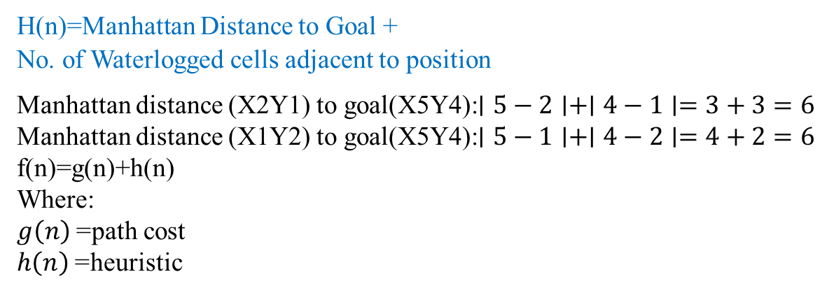
Solution - b) Calculate path cost and heuristic values for all nodes at Level 1–3.
B) Path cost and heuristic values for Levels 1 to 3
Level 1
Node | Path | g(n) | Manhattan distance | Adjacent W cells | h(n) | f(n)
(X2,Y1) | S → X2Y1 | 1 | 6 | 1 | 7 | 8
(X1,Y2) | S → X1Y2 | 1 | 6 | 2 | 8 | 9
H(n)=Manhattan Distance to Goal + No. of Waterlogged cells adjacent to position
Manhattan distance (X2Y1) to goal(X5Y4):$∣5−2∣+∣4−1∣=3+3=6$
Manhattan distance (X1Y2) to goal(X5Y4):$∣5−1∣+∣4−2∣=4+2=6$
f(n)=g(n)+h(n)
Where:
$g\left(n\right)$= path cost
$h\left(n\right)$= heuristic

Slide 11
Solution - b) Calculate path cost and heuristic values for all nodes at Level 1–3.
Level 2
Node | Path | g(n) | Manhattan distance | Adjacent W cells | h(n) | f(n)
(X3,Y2) | S → X2Y1 → X3Y1 → X3Y2 | 3 | 4 | 2 | 6 | 9
Level 2
For (X3,Y2), the adjacent waterlogged cells are:
(X2,Y2) = W
(X3,Y3) = W
So:
h(X3,Y2)=4+2=6
f(n)=g(n)+h(n) = 6+3=9

Slide 12
Solution - b) Calculate path cost and heuristic values for all nodes at Level 1–3.
Level 3
5 minutes for A* algorithm :
Find the valid child, add to open list, choose the next node ………….
Node | Path | g(n) | Manhattan distance | Adjacent W cells | h(n) | f(n)
(X3,Y1) | S → X2Y1 → X3Y1 | 2 | 5 | 0 | 5 | 7

Slide 13
Solution - C) A*
Step 0: Start
Expand (X1,Y1).
Node | g(n) | h(n) | f(n)
(X1,Y1) | 0 | 7 | 7
Step 1: Expand (X1,Y1)
Valid children:
Child | Cell | g(n) | h(n) | f(n)
(X2,Y1) | N | 1 | 7 | 8
(X1,Y2) | N | 1 | 8 | 9
Choose lowest f:(X2,Y1)

Slide 14
Solution - C) A*
Step 2: Expand (X2,Y1)
Valid child:
Node | g(n) | h(n) | f(n)
(X3,Y1) | 2 | 5 | 7
(X1,Y1) | 1 | 0 | 7
(X1,Y1) already visited. Therefore
Open list:
Child | Cell | g(n) | h(n) | f(n)
(X3,Y1) | N | 2 | 5 | 7
Choose:(X3,Y1)

Slide 15
Solution - C) A*
Step 3: Expand (X3,Y1)
Valid child:
Open list:
Tie. Choose (X3,Y2) because it is closer to the goal, that is, it has lower heuristic value.
Child | Cell | g(n) | h(n) | f(n)
(X3,Y2) | N | 3 | 6 | 9
Node | g(n) | h(n) | f(n)
(X3,Y1) | 2 | 5 | 7
(X3,Y2) | 3 | 6 | 9

Slide 16
Solution - C) A*
Step 4: Expand (X3,Y2)
Valid children:
Choose:(X4,Y2)
Step 5: Expand (X4,Y2)
Valid children:
Choose: (X5,Y2)
Child | Cell | g(n) | h(n) | f(n)
(X4,Y2) | N | 4 | 3 | 7
Child | Cell | g(n) | h(n) | f(n)
(X5,Y2) | N | 5 | 2 | 7
(X4,Y3) | N | 5 | 4 | 9

Slide 17
Solution - C) A*
Step 6: Expand (X5,Y2)
Valid children:
Since (X5,Y3) is an energy cell:
g(X5,Y3)=5+(−2)=3
Choose:
(X5,Y3)
Child | Cell | g(n) | h(n) | f(n)
(X4,Y2) | N | 4 | 3 | 7
(X5,Y3) | E | 3 | 1 | 4

Slide 18
Solution - C) A*
Step 7: Expand (X5,Y3)
Valid children:
Choose:
(X5,Y4)
Goal reached.
Child | Cell | g(n) | h(n) | f(n)
(X5,Y4) | G | 4 | 1 | 5
(X4,Y3) | N | 4 | 4 | 8

Slide 19
Solution - C) A*
Final path cost
Step | Cell | Cost
Start | (X1,Y1) S | 0
Down | (X2,Y1) N | +1
Down | (X3,Y1) N | +1
Right | (X3,Y2) N | +1
Down | (X4,Y2) N | +1
Down | (X5,Y2) N | +1
Right | (X5,Y3) E | -2
Right | (X5,Y4) G | +1
Total cost=0+1+1+1+1+1−2+1=4
Therefore, the path is:
(X1,Y1)→(X2,Y1)→(X3,Y1)→(X3,Y2)→(X4,Y2)→(X5,Y2)→(X5,Y3)→(X5,Y4)

Slide 20
PEAS and Environment example
Question 2:
A large supermarket chain wants to implement an Autonomous Checkout System where customers can pick items and walk out without scanning them manually. The system uses cameras, weight sensors, and RFID scanners to track selected items, update the bill, and charge customers automatically through a mobile app.
a. Provide the complete problem formulation.
b. Provide the PEAS description.
c. Identify the various dimensions of the task environment with appropriate justification for each.

Slide 21
Problem formulation, PEAS and Environment example
A supermarket wants an intelligent system that can automatically identify the items picked by customers, update their shopping bill in real time, and charge them when they leave the store, without manual barcode scanning or cashier involvement.
Initial State
The customer enters the supermarket and authenticates through the mobile app.

Slide 22
Problem formulation
Initial conditions:
Customer is identified
Shopping cart/basket is empty
Bill amount = 0
Customer location = store entrance
All store shelves have known item positions and inventory counts
Payment method is linked to the customer account

Slide 23
Problem formulation
Goal State
The customer exits the store, and the system has:
Correctly identified all items taken by the customer
Removed items that were returned to shelves
Generated the final bill
Charged the customer automatically
Updated store inventory
Sent receipt to the customer

Slide 24
Problem formulation
State Space
A state represents the current situation of the supermarket checkout process. It may include:
Customer ID
Customer location inside the store
Items currently picked by the customer
Items returned by the customer
Shelf inventory status
Sensor readings from cameras, RFID scanners, and weight sensors
Current bill amount
Payment status
Exit status

Slide 25
Problem formulation
Example state:
Customer C101 is near Shelf A.
Customer has picked Milk and Bread.
Milk shelf weight decreased by one unit.
RFID tag for Bread detected in customer basket.
Current bill = ₹120.

Slide 26
Problem formulation
Actions
The system and customer actions include:
Customer enters store Customer picks an item Customer returns an item Customer moves between aisles System detects item using cameras, sensors, or RFID System updates cart System recalculates bill Customer exits store System verifies cart System charges customer System updates inventory System sends receipt System raises alert if uncertainty or fraud is detected

Slide 27
Problem formulation
Transition Model
The transition model describes how the system moves from one state to another after an action.
Examples:
If customer picks an item:
Shelf weight decreases
Camera detects hand-item interaction
RFID scanner detects item movement
Customer cart is updated
Bill is increased

Slide 28
Problem formulation
If customer returns an item:
Shelf weight increases
Camera detects item placement
RFID tag returns to shelf region
Customer cart is updated
Bill is reduced
If customer exits:
System finalizes detected items
Payment is processed
Receipt is generated
Inventory is updated

Slide 29
Problem formulation
Goal Test
The goal test checks whether checkout is complete.
Customer has exited the store
All selected items are correctly identified
Final bill is accurate
Payment is successful
Receipt is generated
Inventory is updated

Slide 30
Problem formulation
Path Cost
The path cost may include multiple factors:
Incorrect item detection cost
Delay in billing cos
Customer waiting time
Payment failure cost
Inventory mismatch cost
False fraud alert cost
Sensor processing cost
Customer dissatisfaction cost
The system should minimize:
Billing errors + checkout delay + sensor uncertainty + fraud risk + customer inconvenience

Slide 31
PEAS
PEAS Component | Description
Performance Measure | Accurate item detection, correct billing, fast checkout, low customer waiting time, reduced theft, low false alerts, successful payment, accurate inventory update, high customer satisfaction
Environment | Supermarket aisles, shelves, products, customers, shopping carts/baskets, entry gate, exit gate, mobile app, payment gateway, store inventory database
Actuators | Mobile app notifications, digital bill update, automatic payment trigger, receipt generation, inventory update system, exit gate control, alert system for staff/security
Sensors | Cameras, weight sensors on shelves, RFID scanners, entry/exit sensors, mobile app authentication, payment confirmation system, inventory database inputs

Slide 32
Environment
Dimension | Classification | Justification
Observability | Partially observable | Sensors may miss or misread actions
Agents | Multi-agent | Many customers, staff, and systems interact
Determinism | Stochastic | Sensor errors and human behavior introduce uncertainty
Episodic/Sequential | Sequential | Earlier detections affect final billing
Static/Dynamic | Dynamic | Customers and items change continuously
Discrete/Continuous | Hybrid, mostly continuous | Item identities are discrete, but tracking and sensing are continuous
Known/Unknown | Mostly known | Store rules are known, but behavior and sensor readings are uncertain

